Slide 1
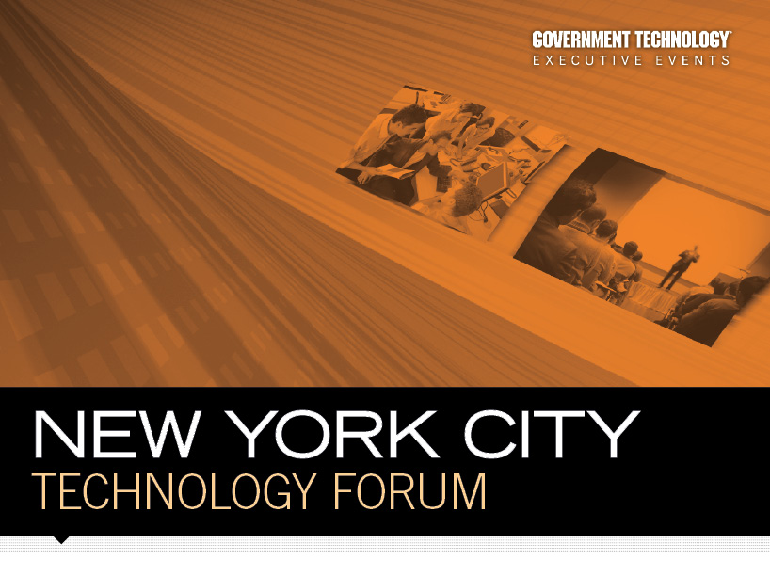

Slide 2
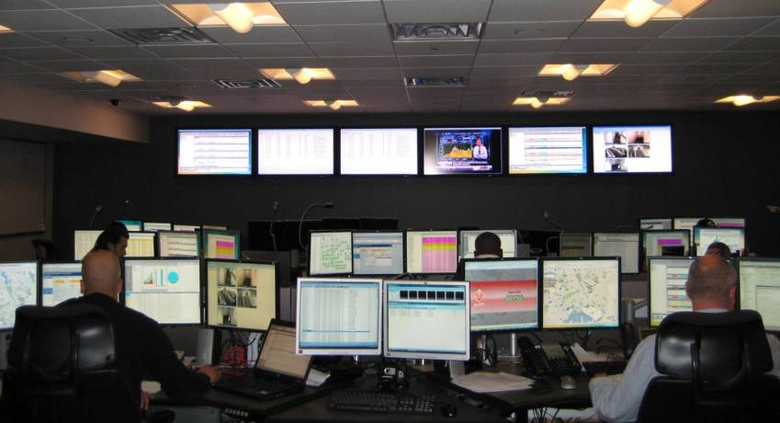
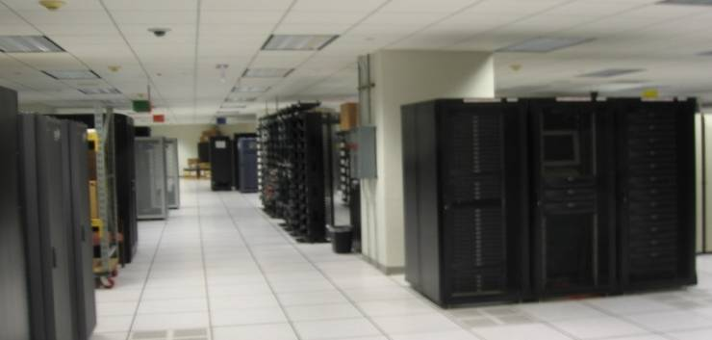
City IT Infrastructure Services
(CITIServ) Overview
15 October 2009
Ron Bergmann
Mike Bimonte
Marilyn King Festa

Slide 3

Agenda
1. CITIServ Overview
2. Governance and Operational Structure
3. Target Model Approach

Slide 4
Mandates for IT Change
Meeting the Mayor’s mandate to become customer focused requires new customer interactions, cross-agency information sharing and a solid foundation of city-wide IT operations.
“New Yorkers expect and deserve responsive customer service….DoITT will undertake a number of efforts to strengthen and rationalize the IT infrastructure, strengthen standards and security, and position the City’s information technology so it can support future development.”
Source: PlanIT NYC, November 2007
“The City shall implement cost-effective programs and energy-efficient practices designed to reduce the City government’s energy consumption and CO2 emissions by 30% ...”
Source: Executive Order 109 & PlaNYC 2030
“In the months ahead, we’ll continue stretching taxpayer dollars further … by consolidating City government’s 55 data centers…”
Source: Mayor’s State of the City Address, January 2009
“…there is a growing need to produce the most computing power per square foot at the lowest possible cost in energy and resources.”
Source: “Data Center Overload” NY Times Magazine, June 8, 2009
“DoITT…shall have the following powers and duties …to provide appropriate, reliable, cost-effective and responsive computer and data communications services to agencies…”
Source: NYC Charter, Chapter 48, Section 1072
Notes:
4
Ron

Slide 5
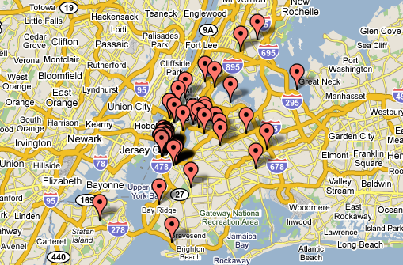
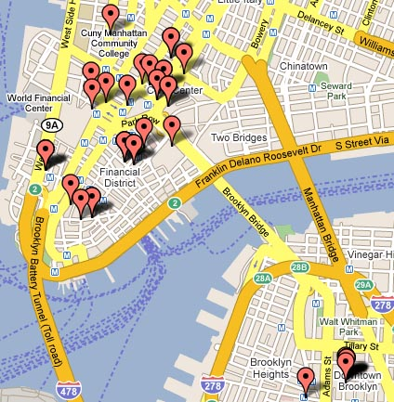
Current Situation – Systemic Inefficiency
Critical information, systems, and IT personnel are scattered across 55+ locations, managed by 40 different agencies, delivering a wide variety of service levels.
This fragmentation results in:
Little City-wide planning or economies of scale
Obstacles to efficient sharing of services and skills
No coherent disaster recovery and security planning
Space, power, and cooling capacity are at their limits for several agencies
Notes:
5
Ron

Slide 6
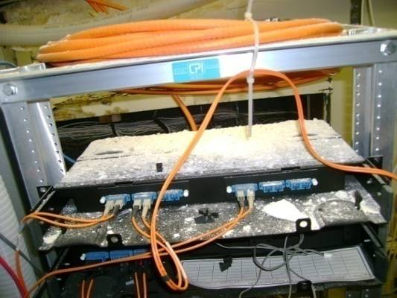
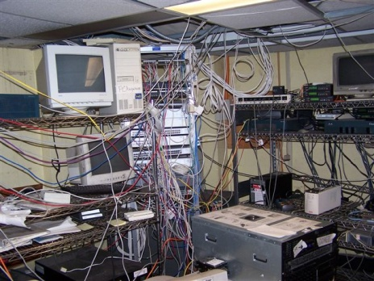
Current Situation –
Many Agency IT Operations are Struggling
DAMAGE
Many of the City’s 55+ data centers lack the critical mass to implement cost-saving and service-strengthening improvements
Inadequate physical facilities result in costly equipment failures and service outages
Wide variation in quality of facilities
  40 agency Data Centers are smaller than 1000 sq. ft.
  Many agency Data Centers do not have sufficient fire suppression
Inconsistent service levels & capabilities
  Many agency Data Centers do not have robust DR plans in place
  Limited 24/7 support
Tactical demands on personnel inhibit long-term planning and maintenance
DISORGANIZATION
Unplanned growth results in increased energy and operational costs
Notes:
6
Ron

Slide 7
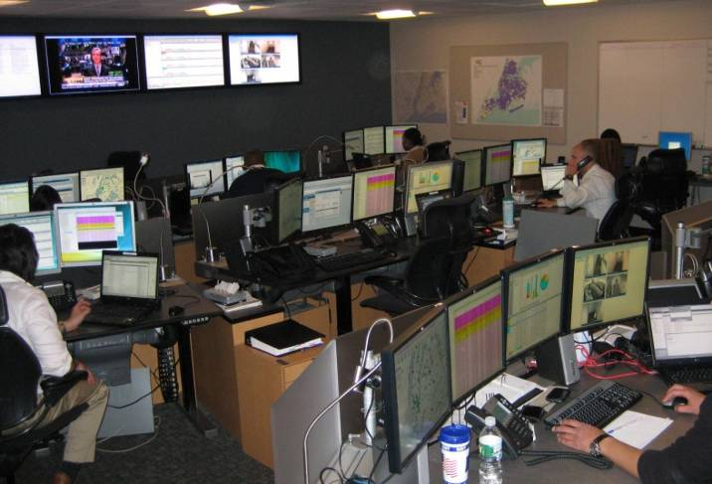
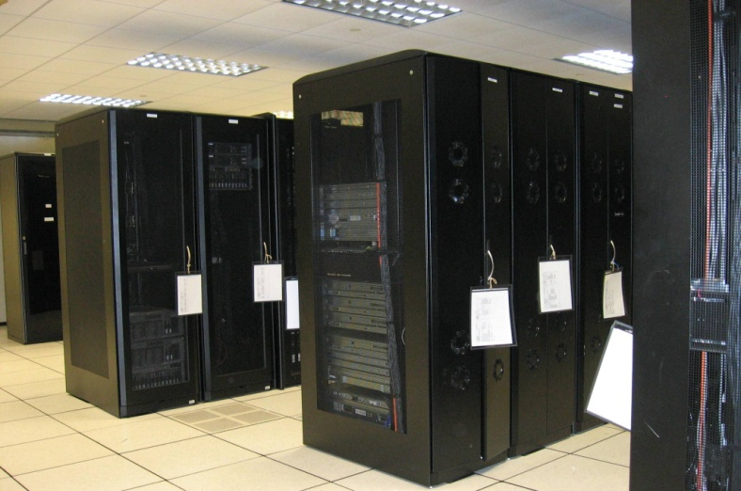
City IT Infrastructure Services (CITIServ) Description
CITIServ establishes an environment in which IT Services can be delivered reliably and efficiently
CITIServ is a program to:
Unify the City’s IT operations
Consolidate existing data centers into a limited number of fully interoperable data centers
Ensure high levels of customer service with well-defined service levels
Improve resiliency, security, and disaster recovery
CITIServ is designed to address current problems and achieve significant cost avoidance for the City
CITIServ will ensure transparency for customers and will be governed by strategic and operational steering committees
Notes:
7
Ron

Slide 8
Benefits - CITIServ Creates Value for NYC
Cost Efficiency
CITIServ dramatically improves utilization of technology and resources
  Provides the City significant cost avoidance over 5 years
  Agencies will share in program savings
CITIServ reduces the City government’s carbon footprint
  Aggregated data centers make 46% more efficient use of electricity for computing and cooling
  Reduces the City’s carbon dioxide emissions by an amount equivalent to 7600 automobiles
  Reduces projected number of processors by 8,000+
Green IT
CITIServ enables improved service levels
  Improved provisioning speed due to standardization of processes
  Improved reliability and problem resolution speed due to simplification of infrastructure
  24x7 operations using up-to-date management automation
Improved IT Services
Agency Business Enablement
CITIServ supports improved agency business execution
  Allows agency resources to focus on core business mission
  Cross-agency sharing of infrastructure reduces per-user cost of IT improvements
CITIServ improves the City’s security posture and resiliency
  Consolidation allows a coherent City-wide DR approach to be implemented
  Enables strengthening of physical and cybersecurity controls
Disaster Recovery / Security
Notes:
8
Ron

Slide 9


CITIServ Provides Green Benefits for the City
Reduced energy consumption / CO2 emissions
  Projected 40+% decrease in electricity use by City Data Centers by end of year 5
  Reduction of approximately 42,000 metric tons of CO2 emitted per year
  Equivalent to the emissions of 7,600 cars
  Equivalent to the CO2 absorption of 1 million medium-growth evergreen trees
Reduced consumption of raw materials and reduced e-waste
  Servers and monitors contain Lead, Cadmium, Mercury, Chromium, Beryllium
  DoITT has eliminated the need for 450+ physical servers through server virtualization since 2005
  CITIServ reduces processors needed by 8,000+ over the next 5 years
Notes:
Ron

Slide 10
Agenda
1. CITIServ Overview
2. Governance and Operational Structure
3. Target Model Approach

Slide 11
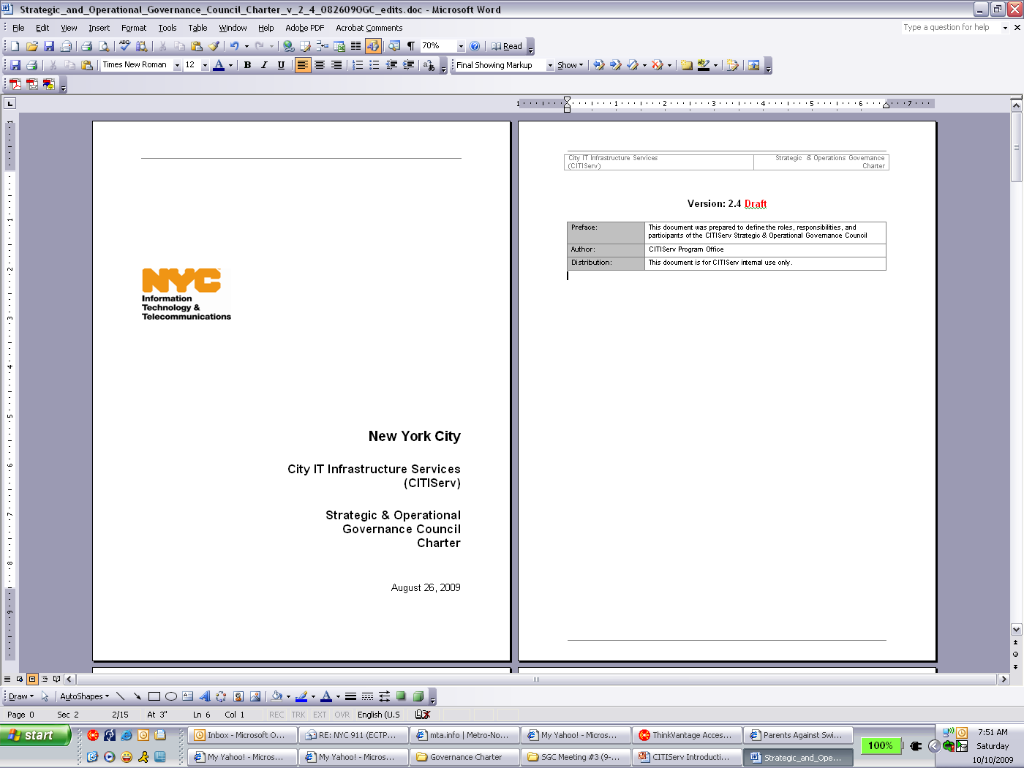
Governance Approach
Establishing the upfront governance approach has been critical for enabling rapid progress
A Governance Charter was developed to articulate roles and accountability across the different governing bodies
Program principles were also developed early to provide clear guidance to decision-making and overarching goals
Notes:
Mike: One of the first things we did was establish some governance bodies to ensure that we had good representation and guidance from across the City.
A formal governance charter was created to help stakeholders understand roles, responsibilities and decision-making accountability.
After this charter was created, the first task that the different governance bodies completed was drafting a set of over-arching principles to guide the CITIServ initiative and get everyone on the same page for approach.
Some examples of key principles include:
Agency budgets will not be adversely impacted by CITIServ.
CITIServ will offer services comparable in scope and features to those of industry leading IT service providers.
CITIServ will offer standard tiers of services and avoid “one off” solutions.

Slide 12
Recap of CITIServ Program Structure
With the governance structure and program office established, CITIServ is managing the parallel execution workstreams that are in motion.
Strategic Governance
Council (SGC)
Governance Bodies
Operations Governance
Council (OGC)
PMO: Program Management and Cross-Workstream Expertise
Program Management
Office (PMO)
PM/QA
Vendor
Execution Workstreams and Support
Service
Offerings & Delivery
Technology
Architecture
Financial Model
Transition Model
SI
SI
SI
SI
Notes:
07/25/09
12
Mike: This slide shows the different governing bodies that were created.
On the top, there is a Strategic Governance Council. This group has a cross section of NYC stakeholders who will actively contribute to the success and CITIServ, including Deputy Mayor representation, Mayor’s Office of Operations, OMB, and other key stakeholders.
The other main governing body is the Operations Governance Council. This group is responsible for making CITIServ operational decisions, overseeing the CITIServ program and addressing issues that impact the execution of the CITIServ program plan. Marilyn and I are the co-chairs of this group, and the other members include IT Directors and CIOs from multiple agencies.
Under these governing bodies, we have stood up a formal Program Management Office to oversee the different parallel workstreams and CITIServ activities. There are several teams working on different dimensions of the CITIServ programs such as the Service Offerings, Technology Architecture, etc.
We are also going to be getting assistance from external resources through PM/QA and SI support.

Slide 13
CITIServ Governance Structure
Strategic Governance Council
Operations Governance Council
Role
  Set direction of CITIServ program
  Resolve critical issues
  Escalate decisions as needed
Decisions in Scope
  Review CITIServ program performance against schedule, cost & benefits and adjust direction as needed
  Review major changes to Program
  Address Organizational issues
  Review CITIServ funding and recommend changes to program as needed
Participants (12-15)
  Strategic Governance Chair (DoITT CIO)
  Deputy Mayor representatives
  Office of Management & Budget
  Mayor’s Office of Operations
  Operations Governance Council Chair
Role
  Advise on priorities for CITIServ rollout and operations
  Guide CITIServ Program Mgmt. Office
  Escalate decisions to SGC as needed
Decisions in Scope
  Define CITIServ Service Offerings and Service Levels
  Review program plan and adjustments to plan over time
  Prioritize portfolio of improvement initiatives
  Establish CITIServ funding requirements
Participants (9-12)
  Operations Governance Co-Chairs (Agency CIO & DoITT Operations Lead)
  Agency CIOs
  OMB Representative
  CITIServ Program Manager
  Shared Service Delivery Lead(s)
  Relationship Management Lead
  Subject Matter Experts
Strategic Governance Council
Operations Governance Council
Agency Representatives
CITIServ Program
Management
Office
Notes:
Mike: Now that you have the big picture of the different governance bodies and team structure, we wanted to drill a little deeper into the roles of the two main councils, the SGC and the OGC.
The SGC really is charged with:
Making strategic decisions that enable CITIServ to achieve its intended goals
Ensuring the needs of the City, Agencies and CITIServ are balanced
The OGC focuses on:
Advising on priorities for the CITIServ target model, rollout approach and operations
Guiding the CITIServ PMO
These two councils have been working well over the past months because we took the time upfront to ensure the participation balanced and the expectations in the governance council were clear. Also, the OGC has been able to make parallel progress on several different areas by forming sub-groups to rapidly develop strategies that the rest of the group works together to refine.

Slide 14
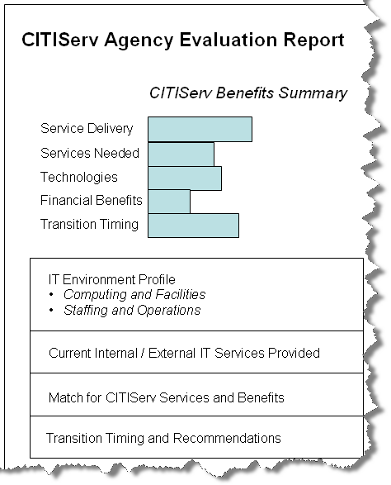
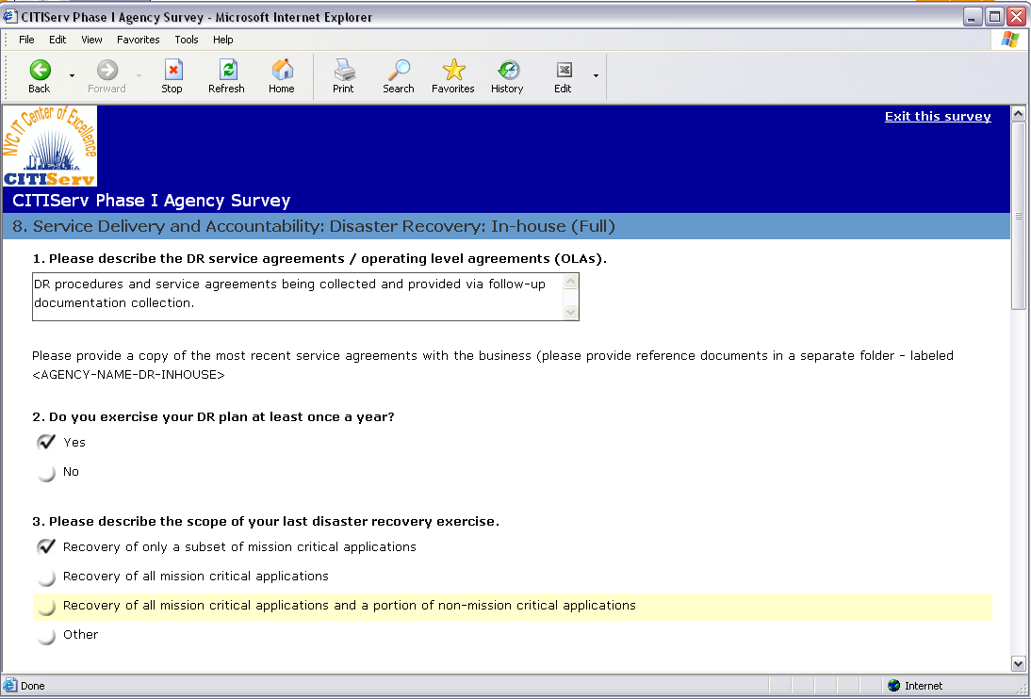
Identifying Benefits and Sequencing for Initial Phase
Currently the Operations Governance Council is piloting a series of benefits analysis surveys to identify candidates for Phase 1 and timing for migration to CITIServ services.
Notes:
Mike: One of the key workstreams that the OGC has been working on recently is
The OGC created a set of criteria to identify the different types of benefits that agencies could achieve through the CITIServ program. We have been piloting a web-based survey and evaluation process with several agencies to use these criteria for capturing opportunities and considerations for migrating to CITIServ.
For example, if an agency currently doesn’t have robust disaster recovery or monitoring or service management capabilities in place, these are identified so that we can understand more about the potential benefits that could be received. This will ultimately be used to help prioritize migration to CITIServ services and the different phase timing.
As we complete our pilot, we will be incorporating the lessons learned and feedback from the agencies that participated so that the survey and evaluation process can be expanded to other agencies for the analysis.

Slide 15
CITIServ Will Be Executed in Phases
Phase I: Now – 2010
  Hosting in 2 MTC Facility
    11,000 sq ft
    Existing data center in building with near Tier 3 rating and comparable to DoITT data center at 11 MTC
    Ready for CITIServ occupancy within 6 months
    Cost advantages due to existing infrastructure
  Prove out target model by piloting with up to five agencies
  Establish and measure improvements delivered to demonstrate benefits of program
  Disaster Recovery needs addressed as required leveraging existing facilities
Phase II: 2010 - 2014
  Continued expansion of 2 MTC and addition of a second data center facility
  Existing agency data center facilities leveraged to best meet City needs during interim build period
  Services and operations managed through new CITIServ target model
  New IT Services and service levels available
  Disaster Recovery provided strategically by leveraging two main data centers
  Cost Savings and Green IT benefits fully realized
Notes:
Mike: The output from the broader agency survey process will allow us to map out the phases in more detail. This slide shows the high-level approach for the first phase.
Phase 1 CITIServ services will be hosted in 2MTC and focus on small group of agencies to prove out the target model and demonstrate the benefits of the program.
Phase 2 will add in more incremental waves of agencies, additional services and expanded facilities.
Now I’m going to turn it over to Marilyn to walk us through the different components of the CITIServ Target Model.

Slide 16
Agenda
1. CITIServ Overview
2. Governance and Operational Structure
3. Target Model Approach

Slide 17
Target Model Components
A Target Model is currently being developed to describe the detailed design of how CITIServ will function
The CITIServ Target Model includes five components:
Service Offerings
Technology Architecture
Service Delivery and Support Model
Financial Model
Transition Model
Service Offerings
Technology Architecture
Service Delivery & Support Model
Financial Model
Transition Model
The purpose of the Target Model is to communicate the CITIServ approach:
Define the scope, guiding principles, metrics and measures for the CITIServ program
Establish agency/user expectations
Communicate standards to agency IT personnel and third party service providers
Notes:
The Target model articulates the ITIServ services, processes and technology, including:
Design and configuration of network, platform and storage infrastructure
Agency integration plans and roadmaps
Process changes or new processes needed for measuring, reporting, delivering services
New or changed accounting mechanisms

Slide 18
CITIServ Target Model Components:
Service Offerings
What does Service Offerings cover?
What are the design principles?
How will this be developed?
Definitions of services based on feature, function and service levels
Processes for managing and prioritizing changes to the service portfolio in response to City-wide and agency needs
  Offer services comparable in scope and features to those of industry leading IT service providers
  Leverage external clouds and other third-party services when necessary
  Offer standard tiers of services
  Avoid “one off” solutions when possible
  Publish full details in a Service Catalog
Design Goals and Principles
Service Definitions and Benefits
Service Metrics and Measures
On-line Services Catalog
Notes:
For each of the five Target Model components, we have compiled three views:
- an overview of what is covered in this dimension of the Target Model
- the principles for this dimension that were previously developed
- the next step actions that the OGC and core team are conducting to define the Target Model
For the service offerings, we are currently defining the first phase of offerings:
Service Desk
Hosting Services
Collaboration Services
Network Services
The services that CITIServ offers will evolve over time into a robust portfolio.
The initial services are being selected based on current capabilities to consistently deliver the service with high quality and agency demand for the service.
New or expanded services in the pipeline will include broader Disaster Recovery capabiltiies and many other offerings.

Slide 19
CITIServ Target Model Components:
Technology Architecture
What does Technology Architecture cover?
What are the design principles?
How will this be developed?
Design and configuration of network, platform and storage infrastructure
Adjustments based on requirements for connectivity, redundancy, security, capacity and exception handling
Processes for managing the environment, adding technology when appropriate, and retiring technology as needed
  Leverage a standardized technology environment to enable efficiency and agility
  Operate data centers and related infrastructure to serve the best interests of the City and agencies
  Add technology domains and services based on agency needs
  Agencies’ business applications and data will be managed by agencies within the enterprise architecture to facilitate information sharing
Design Goals and Principles
Data Center Facilities Architecture
Network Architecture
Processing and Storage Platform Architecture
Technology Services Architecture
Integration and Tools Architecture
Contingency and Disaster Recovery Architecture

Slide 20
CITIServ Target Model Components:
Service Delivery and Support Model
What does the Service Delivery and Support Model cover?
What are the design principles?
How will this be developed?
Critical service delivery and support processes needed for managing, measuring, and reporting on the delivered services
Service delivery roles, responsibilities and relationship management
Agency integration plans and roadmaps
Product selection and configuration for operations software and hardware
  Define service levels with stakeholders
  Implement robust processes for measuring actual service delivery performance
  Provide transparency to agencies as to performance against service levels
  Assess customer satisfaction
  Establish mechanisms to promote open communication with agencies
Design Goals and Principles
Service Delivery Processes
Service Delivery Tools
Service Delivery Teams

Slide 21
CITIServ Target Model Components:
Financial Model
What does the Financial Model cover?
What are the design principles?
How will this be developed?
Processes for collecting ongoing cost information for all CITIServ services so that the total lifecycle cost of services can be accurately compared to the value delivered by those services over time
New or changed accounting mechanisms
  Agency budgets will not be adversely impacted
  Implement a process for establishing a baseline for IT costs and a financial model for tiered services
Document Design Goals and Principles
Determine financial / chargeback approach
Determine forecasting / budgeting model
Determine asset ownership model

Slide 22
CITIServ Target Model Components:
Transition Model
What does the Transition Model cover?
What are the design principles?
How will this be developed?
Framework for coordinating all aspects of the migration to CITIServ
Collaborative approach to all transition considerations across people, processes and technology
Comprehensive planning to minimize risk and disruption while ensure a successful migration
  Collaborate with agencies to determine the best plan for the integration of agency IT services and resources
  Manage transition activities using ITIL best practices
  Transition to the target state will be managed so that agencies do not experience a deterioration in services
  Agencies will provide CITIServ with access to facilities and systems, as well as access to technical documentation, service/ performance data and cost data
Document Design Goals and Principles
Services Transition Model
Application Transition Options
Staffing Model Options
Measuring Progress
Contingency Planning Options
Transition Pacing Approach
Deployment Planning

Slide 23
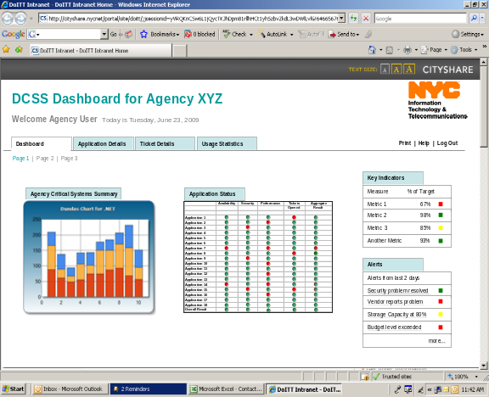
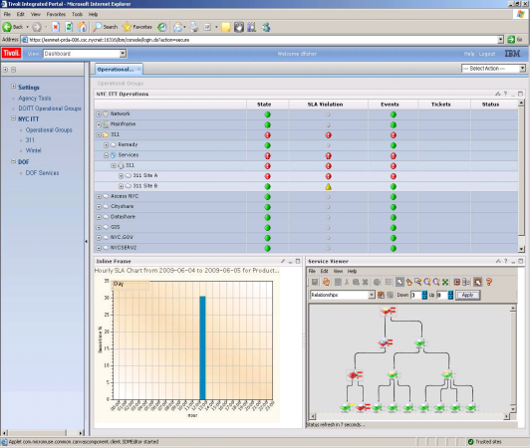
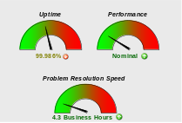
Closing Comments: Agencies Will Benefit from CITIServ Customer Experience Improvements
CITIServ will provide an improved Agency “IT customer experience”
Defined IT services and service levels
Relationship management
Customized and transparent agency-specific dashboards that provide:
  The state of agency systems
  CITIServ performance vs. service levels
  Other critical metrics as agreed upon

Slide 24

Transform
The City Through Consolidation
And Cloud
Computing
Regina Kunkle
NetApp, Inc.

Slide 25


Trends & Challenges of IT organizations
Growth and new technology demand more power and space – creating tensions between Business and IT functions.
IT departments need to innovate to balance all of these challenges and deliver value to the business
25

Slide 26
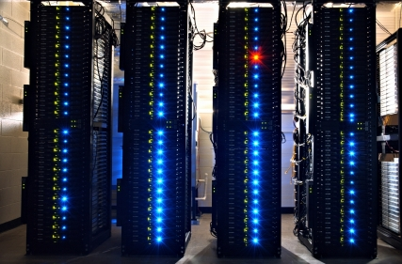


How are IT Organizations Responding
Three, basic strategies have emerged….
Optimize what you have and do going forward - Consolidate and Virtualize
Deploy eco-friendly technologies to optimize space & power
Re-locate facilities to lower cost geographies

Slide 27
The Power Challenge
140
120
100
80
60
40
20
0
Historical energy use
Future energy
Use projections
Historical trends
scenario
Current efficiency
trends scenario
Improved operation
scenario
Best practice scenario
State of the art scenario
2000 2001 2002 2003 2004 2005 2006 2007 2008 2009 2010 2011
EPA Report Comparison of Projected Electricity Use, All Scenarios, 2007 to 2011
Potential savings in power > equal to that used by 7 million homes/yr
Potential savings in carbon > equal to the emissions of 10 million cars/yr
Cost savings and Social responsibility are at issue
27
Notes:
Suggested discussion:
The results of the scenario analyses indicate that in the absence of any efficiency gains during the next five years, the aggregate electricity use associated with U.S. servers and data centers would more than double from 2006 to 2011. The total 2011 electricity use in the historical trends scenario is estimated at about 125 billion kWh, or about 2.9 percent of total projected nationwide electricity use in 2011 (US DOE 2007a). (source – EPA report)
All scenarios are calculated based on probable PUE scenarios
If you look at the data, the power savings potential if we move to State of the Art scenarios are power savings equal to that required to power 7 million homes annually and carbon reductions equal to removing 10 million cars annually.
These represent real cost savings and true environmental responsibility impacts.
Other Data:
Data Center Subsystem
Scenario
IT Equipment
Site Infrastructure (Power and Cooling)
Continue current trends for server consolidation 30% improvement in infrastructure energy efficiency from improved airflow management
• Eliminate unused servers (e.g., legacy applications)
Improved operation
• Adopt “energy-efficient” servers to modest level
• Enable power management on 100% of applicable servers
• Assume modest decline in energy use of enterprise storage equipment
Best practice
All measures in “Improved operation” scenario, plus: • Consolidate servers to moderate extent • Aggressively adopt “energy-efficient” servers • Assume moderate storage consolidation
Up to 70% improvement in infrastructure energy efficiency from all measures in “Improved operation” scenario, plus: • improved transformers and uninterruptible power supplies • improved efficiency chillers, fans, and pumps • free cooling
State-of-the- art
All measures in “Best practice” scenario, plus: • Aggressively consolidate servers • Aggressively consolidate storage • Enable power management at data center level of applications, servers, and equipment for networking and storage
Up to 80% improvement in infrastructure energy efficiency, due to all measures in “Best practice” scenario, plus: • direct liquid cooling • combined heat and power
27

Slide 28


What NetApp IT is Doing . . .
© 2008 NetApp. All rights reserved.
28

Slide 29








Supporting a Globally Distributed IT Organization
8,000+ employees; 350+ in IT
Distributed in 46 countries with 130+ offices
6 Global data centers:
Americas (3), Europe, India, Hong Kong
Over 100 Applications
Over 260 NetApp FAS Systems
1500 Servers
2.5+ PB storage
29
29
Notes:
29
29
The purpose of this slide is to set the context for what NetApp IT is, how much we manage, and set the understanding for the level of complexity in running and growing this ecosystem.
NetApp is almost 7,600 employees spread around the globe in 46 Countries that house 130 offices. There are also a large number of employees that work in the field from home offices in additional countries. There are about 400 employees in IT – with another few hundred FTEs that are staff augmentation or Service Providers. All told, there are closer to 9,000 actual FTEs that use IT services in NetApp
Our data center footprint is positioned to deliver single global instances of all our applications around the world. These applications are delivered from two primary datacenters. Sunnyvale and Sacramento California. The other datacenters located in Amsterdam, Bangalore, Raleigh NC and Hong Kong are positioned to deliver regional applications such as Exchange Email and serve home directory file shares to regional employees.
NetApp’s application portfolio is extremely complex. Running 6 highly integrated tier 1 applications. Our approach has been to run mission critical Enterprise applications on our gear – to demonstrate our value add over out competitors. To achieve this we have ended up with a best of breed set of apps where most are focused on one business function and communicate real-time with others to form the business functions NetApp requires:
Vantive is used for just CRM, SAP will replace this in July of 2008
Siebel is used just for Sales Force Automation
PeopleSoft is used just for HR
Oracle rounds out the field and is our core ERP system
Tibco ties them all together as well as providing various B2B connections where required.
NetApp’s overall physical footprint consists of more than 1,700 servers based on our standards of IBM BladeCenters for Windows and Linux, Fujitsu 1500’s to meet the Solaris demands and the IBM P Series for our large database applications and SAP.
There is more than 3 petabytes of raw storage allocated throughout the 6 datacenters to support all of our storage needs , with 2.5 petabytes allocated to applications.

Slide 30
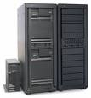
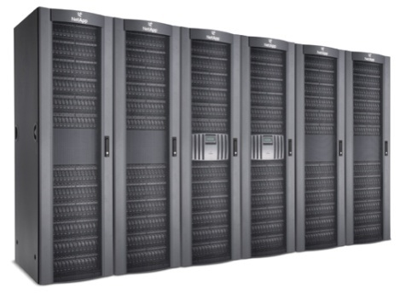
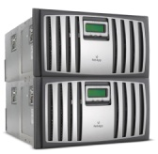
Challenge NetApp Faced 4 Years Ago
Data Center Sprawl
Data Centers in 57 Field Offices
Power Issues
Power costs spiraling AND rolling brown outs in CA, HQ
Duplicate Resources
For e.g., Each Engineering team had its own Test lab
Inability to Scale Quickly
New employees, increased volumes of orders

Slide 31
Our Architectural Strategy- 3 C’s
Category | Description | Example
Convergence | Converge on to a minimal number of Vendors, Technologies and platforms. | Oracle Cisco Microsoft Intel Architecture
Consolidation | Consolidate to eliminate redundancy, and drive convergence. Upfront investment will be required to transition, and will simplification of process to remove customization | Consolidate Data Centers Servers, Storage Virtualization to drive up capacity utilization.
Cloud | Optimal Sourcing strategy capability spectrum ranging from : Some applications moved to Cloud Some are their own private Cloud All Receive Cloud Services – backup/DR | On.premise dedicated (ASP) On.premise private cloud SAAS Public cloud PAAS IAAS DAAS

Slide 32
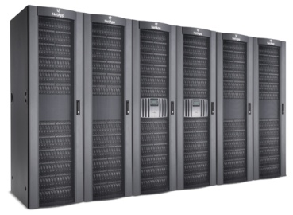

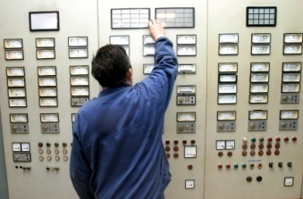
Our Approach
Not a wholesale swap-out, implement as a go-forward architecture
Challenge every asset refresh and new project
Innovatively apply NetApp technology to Data and Storage Management –
  High Efficiency tools like DeDuplication and Thin Provisioning to reduce Storage Footprint
Innovate through Space and Energy Management
  Challenge old assumptions (“near the gear”, each app needs dedicated resources)

Slide 33
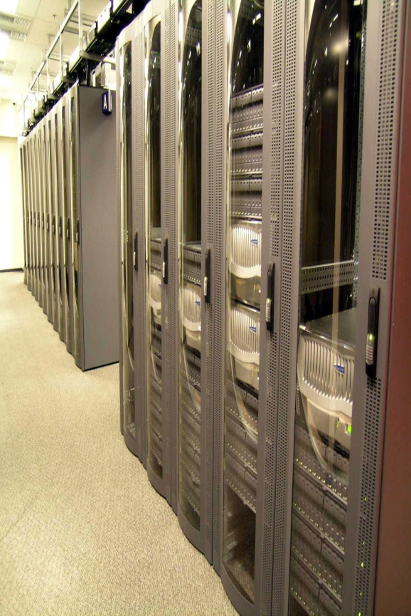
Server Consolidation and Virtualization
  Consolidated from 57 Data Centers to 2
  Reduced Storage Systems by 80%
  Freed 19.5 racks in the data center
  Eliminated 41,184 KWh per month, reducing energy consumption by 32%
  Eliminated 94 tons of air conditioning
  Increased storage utilization by 60% (from 40-60%)
  Consolidated all of engineering into 1000 Blade Grid
Optimize storage utilization, energy and space consumption while scaling for growth
33
Notes:
33
Solution:
Create Storage Service leveraging Data ONTAP® 7G, FlexVol™and FAS 980s to consolidate data and refresh aging assets

Slide 34
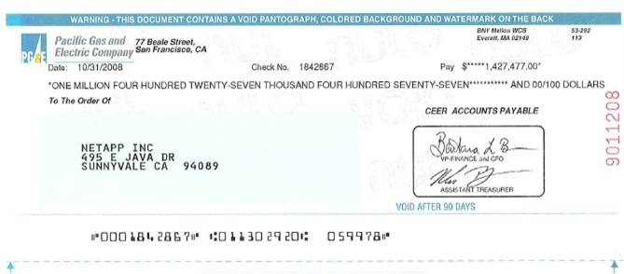
Results - $2.2M in Energy Rebates and Incentives
Saving NetApp one million KWh of energy per year.

Slide 35


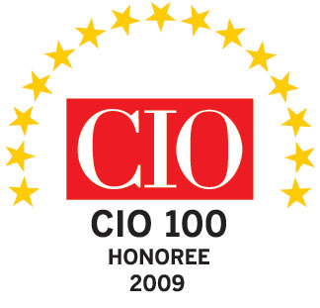


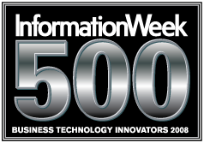




Recognized Leader in Environmental Responsibility
2009
2008
2007
2006
2005
2004
2003
Green Enterprise IT Awards
Best in Class Implementation Winner
The Uptime Institute Global Green 100
Notes:
Suggested discussion:
NetApp is a leader in participation – and recognized for our results and controbutions-
Green Grid
SNIA Green Storage Initiative, Governing Board
US EPA Energy Star requirements study
DOE/ EPA National Data Center Energy Efficiency Program
And most recently, out IT organization was ranked #14 on the InformationWeek 500 and as #1 in the the Information Technology Industry Vertical

Slide 36
Lessons Learned
Consolidation & Virtualization
  Partner with applications teams to understand dependencies – this is not just infrastructure
  Be conservative in initial time line commitments until you have experience
  Operation of consolidated systems requires changes in processes –
  Change Management and Release Management require more rigor in a virtualized world
  Start with non-critical, non-production, low risk assets
Deploying eco-friendly technologies to optimize space & power
  Crucial for IT and Facilities to partner
  Have a plan to optimize credits & rebates from local utilities
Re-locate facilities to lower cost geographies
  Delivering a single instance global application suite requires sensitivity to distance – drives geographic choice.
  Per KWh pricing ranges from $.02 to $.12 in North America – don’t feel that you must be “near your gear”
36

Slide 37
OPPORTUNITY for Consolidation In NYC
Cost & Resource savings
Increase speed of delivering application by improving Test/dev to production
Only consume what you need, when you need it, at a reasonable cost
Your data is secure and protected
Data center consolidation requires a change in mind set of “my goal is to survive” to look at it as “an opportunity to increase my capabilities”

Slide 38
Enabling Cloud Architecture

Slide 39
Path to the Private Cloud - A journey
IT as a Service
Self-service
Automate
Cost Reduction & Flexibility
Virtualize &
Consolidate
Standardize
Offering
Centralize IT
Time
Notes:
Catch phrases are in abundance to describe the journey to IT-as-a-Service. Semantics aside, many leading enterprise have already began to take steps to provide a foundation for this new model. This adoption is usually characterized by the following five phases:
<Click>
Centralize management of IT to gain visibility of costs, take control of the IT offering and gain economies of scale and begin the journey to service oriented infrastructure.
<Click>
Standardize the offering based on the key business requirements. Attempting to support bespoke solutions for each application is costly, slow to provision, Standardization of offering and creating repeatable processes is key to improving quality, provisioning times, and reduce support cost and risk. Standardization is a prerequisite to successful consolidation and automation.
<Click>
Virtualize and Consolidate the physical infrastructure. Virtualization consolidation, driving up asset utilization and with NetApp massive storage efficiency benefits. Virtualization happens at each level of the infrastructure stack; storage and data protection, network, and server layers to increase asset utilization and simplify asset lifecycle management through mobility of applications and data. With shared services and multitenancy come much faster time to market and considerably lower overall cost structures, and entails the responsibility of non-stop infrastructure. You’ve got the basis of service oriented infrastructure (SOI).
<Click>
Automate the environment. Once the offering and processes are standardized and infrastructure virtualized the step of automation is possible. Automation tools increased abstraction providing simply controls for overall workflow management.
<Click>
Self-service and APIs for delegated control. Handing back control is the crowning achievement. Allowing application administrators and owners the flexibility of scaling on demand, choosing different levels of performance and data protection as required, and automating recovery from applications errors are all possible through application integration and self-service capabilities making the jump from service oriented infrastructure to enterprise cloud services.
The end state provides a business model characterized by contracting for data center offerings at an agreed level of service through a service catalog.
<Transition to next slide>
So the real question isn’t what is a dynamic data center, but more importantly “why should I care?”

Slide 40



What Drives Cloud Adoption
Enterprise IT Benefits
Scalability
High Availability
Pay-as-you-go efficiency
Data access any time,
any where
Predictable cost structure
Operational efficiency
Business Benefits
Turn capex into opex
Faster business innovation
Risk sharing with vendors
Increased productivity
Scalable
Cost efficient
Flexible
Notes:
Key points : To communicate the different business, business unit, and IT drivers to adopt the cloud model.
Note: Ultimately, IT drivers serve a company’s overall business objective.

Slide 41





Key Technology Piece:
Secure Multi-Tenancy Capability
Create secure virtual partitions within the same Storage System
Increase storage utilization a in shared infrastructure
Multi-Tenancy is a proven NetApp technology
  Over 16,000 licenses sold
Agency A
Agency B
Agency C
Program 1
Program 2
Shared Applications A, B, C…
Virtual Storage Controllers
Virtual Storage Controllers
Virtual Storage Controllers
41
Notes:
First introduce the concept of Multitenancy, what it is. Second is the benefit, why use it, importance in cloud environment. Third, NetApp has been supporting this for a long time with proven track record of 16000 license…
41

Slide 42


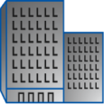









NetApp’s ITaaS Cloud Architecture:
NetApp Dynamic Data Center Solution
Building a service-oriented dynamic data center is a journey
NetApp has the expertise
  Proven practices generated by serving customers
  We have done it for ourselves
  Summarized in NetApp® Dynamic Data Center Solution (NDDC)
We can help you get there sooner at less cost
IT as a Service (ITaaS)
Applications
Compute | Physical
& Virtual Servers
IaaS
Unified Network Fabric
Multiclient Service Management
Service
Catalog
NetApp Unified Storage
Consolidation & Virtualization
Integrated Data Protection
Notes:
42
42
Purpose of this slide: Introduce NDDC, the proven framework to help customers deploy cloud infrastructures.
Not only do we have the technology, we also have a proven framework to help you implement deployment. The implementation framework is built on proven practices through helping many customers go through the same experience, the same journey.
Storage Efficiency

Slide 43
Questions?

Slide 44
Computing as you want it, when you want it.
Stephen R. Kovac
Vice President Global Services
Security and IT Services
Federal / Government / Education Markets

Slide 45
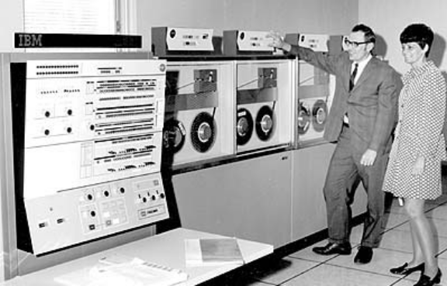

Computing and Communications
Past, Present and Future
Sixties - Seventies
  Mainframe computing
  Closed networks, phone, fax
  Physical security
Eighties – Early Nineties
  Client / Server computing
  Leased lines, Frame Relay, ATM
  Anti-virus
Nineties – Early 21st Century
  Web-based computing (browser is the client)
  Internet, Private IP networks
  Firewalls, VPN, Intrusion Detection, Anti-spam
Present and Near Future
  Cloud computing
  IP everywhere
  Security embedded in everything
Notes:
So, but you first think you need to reflect back on a little history and think about how we as a business have evolved with the industry and certainly with technology.
If you go back into the '60s and '70s, certainly, it was a mainframe computing environment and what did we play there, right?
We had a phone line we could connect to that environment, but pretty much it was a very physical, secured environment, and that's what we had.
But then the '80s calm along and we started breaking apart the computing from the actual client itself, right, the client server environment.
All of a sudden the boom that we had in frame relay and ATM, and actually even securities started to become a major play to that, because you needed to secure the fact that the environment was being broken apart and distributed.
Then as we know in the 1990s and beyond, the web‑based computing environment and browsers come into play and all of a sudden, pip grew like you wouldn't believe, internet was, you know, the main way that everybody got business done and all of a sudden, security was extremely important, because think about it ‑‑ we have gone from that one data center environment to now this very distributed environment.
And now, you can't pick up a trade magazine without thinking about or reading about cloud computing.
And I'll tell you that's because I.P. is everywhere.
We joke and say that toasters are not I.P.‑enabled.
We're not far off that.
Postal machines and coke machines are I.P. enabled.
Basically everything now has the ability to work on a network.
And when you are in that environment, in this environment, one of the MOFRT for factors is security.
I'm going to talk about the key ingredients as we go forward and why we're positioned well.

Slide 46
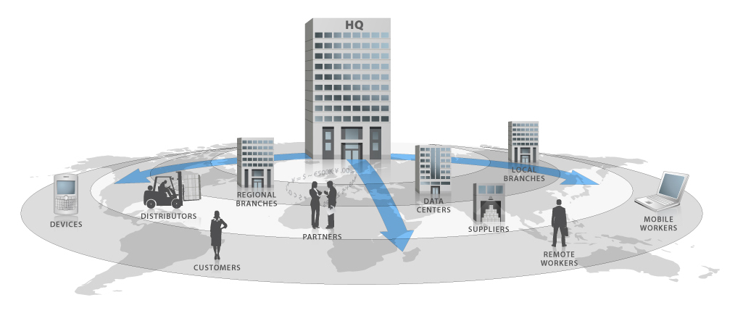
A New Business Model
Enterprises around the world are transforming their business to operate within
a new business model – a model we refer to as the Extended Enterprise
Customers, employees, partners
and suppliers are everywhere
More complex security, IT and
network challenges
Business is data, and data
is everywhere
Legacy infrastructure no longer
meets the needs of business
Limited resources, expertise & capital
Multiple compliance needs & drivers
Increasing speed to market
Growing environmental pressures
and expectations
Expectations of 24x7 global service

Slide 47
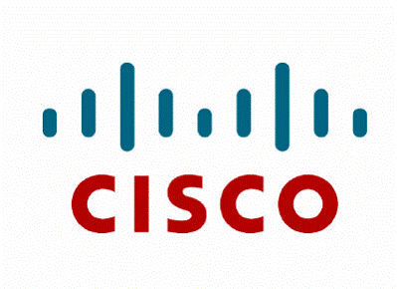

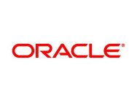
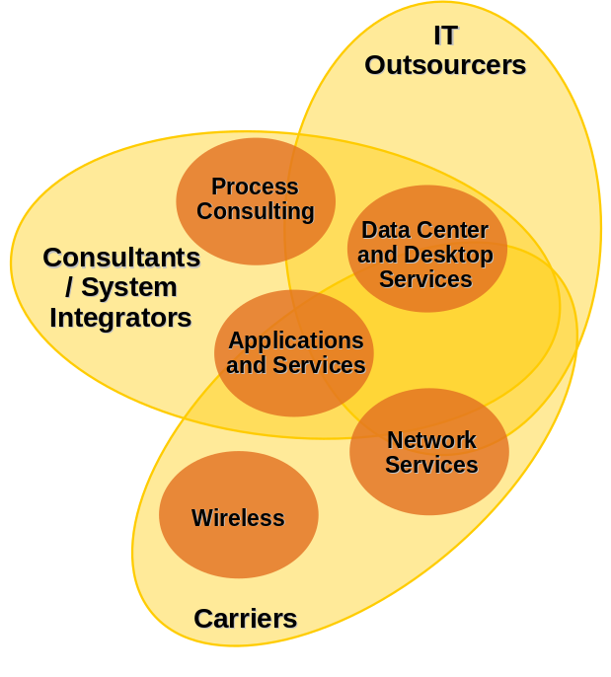






Computing and Communications
Today’s Market Place
Extended Enterprise Value Chain
Business Processes
Business Applications
IT Infrastructure
Communications
Network
Enabling Hardware & Software
Security
Notes:
But let's first look at market a little bit.
I think that this whole IP enablement has created a true industry identity crisis.
I mean, look at what just happened.
Oracle is acquiring sun.
HP acquired EDS or they merged together.
If you look at what's happening between the IT outsourcer systems integrators and carriers, you see this merging in this tighty crisis of who is doing what.
In the systems integration space, think about it, they thought about applications, and all of a sudden now they're driving further down into the network because the cloud is all about the network.
They have to be in that space.
When you look at outsourcing, this is interesting to me ‑‑ more and more companies ‑‑ you heard Fran talk about J & J.
That's a good example of a transformation that's happened in that space.
Many companies like J & J have picked an application outsourcing company and they picked an infrastructure outsourcing company.
Guess what, that is in the case of Johnson & Johnson, that's HP/EDS and Verizon.
That's starting to move and the carriers are trying to fight the challenge that the other two groups want to push us down and drive to us commoditiation.
I think when you think of the cloud, we're the perfectly positioned player in that space.

Slide 48

Our Sweet Spot
Delivering Converged Business Solutions
Extended Enterprise Value Chain
Business Processes
Business Applications
IT Infrastructure
Communications
Network
Through Partnerships
Example: Accenture
Security
Verizon Business is a leading global
communications, IT and security solutions partner to businesses and government.
Notes:
So, if you look at our sweet spot and all of us should think about this as we are talking to customers and as we are talking to internal teams and we're developing solutions, what is our sweet spot?
And I think if you break it apart in the infrastructure outsourcing area, and the application outsourcing area, we have a very defined area that we're very good at.
We can make those business applications strong.
We can make sure they're secure and they're reliable.
We also have the opportunity, and you have heard us as an example in a partner ships working with companies like Accenture.
Their great at the business process outsourcing.
They know how to develop the large scale applications.
S.
We know how to make them run in a very secure, reliable format.
So, if you look at who we are in this change at the beginning of the year, you see where communication, I.T., security solutions and we're enabling those business solutions.
Clearly the sweet spot and we're well pokesed in that space.

Slide 49
Taxonomy of a Cloud Provider
Enterprise Viewpoint
Foundational
Elements
Service
Elements
Security is a leading adoption inhibitor
Enterprises are looking for flexibility
Customer Tools to provide self provisioning and transparency of information
Professional Services to help with a comprehensive strategy for adoption and migration
Network Assets
Security
Data Centers
Flexibility
Metering/Billing
Transparency
Access to Capital
TCO
Notes:
There are many cloud providers in and coming to market but their not all created equal. A Recent Gartner survey indicated that the biggest inhibitors over pursuing cloud based services were mostly surrounding risk mitigation and data security concerns. A recent CIO survey exposed this concern as well with over 40% of respondents (largest segment) calling security the greatest concern regarding adoption. Many of the market analysts, and we believe that security must be front and center in provider’s capability set.
Next is flexibility - - offering options / choice in the areas of connectivity and types of resources.
Also, when considering a managed service you want to ensure that the providers you are considering provide you transparency so that you can see the status of your environment and obtain reports on usage, capacity and trouble tickets quickly and easily. Finally, be able to give you help when you need it offering Professional Services to help with a comprehensive strategy for adoption and migration of applications – or how to integrate the cloud environment with your dedicated environments.

Slide 50
Customer Challenges
Customers are faced with a common set of challenges centered around improving performance of applications and infrastructure while controlling costs
Common challenges include:
Traditional method:
Plan to peak
Each department or business application was in a silo with dedicated resources
Demand varies over time
Idle servers waste capital,
power and cooling, and
data center space
Traditional method: Need a feature, buy a box
Cannot scale quickly for fluctuating business cycles
Loss of flexibility
Once locked into dedicated infrastructure, you become rapidly overtaken by
technology advancements
Traditional method:
Need redundancy – buy
two of everything
Capital intensive,
significantly drives up cost
Complex in nature and
difficult to manage
Must sacrifice flexibility
  Managing the cost of
  underutilized resources
Traditional method: IT as
cost center for business
Difficult to prioritize
individual needs
Difficult to perform as
value center
Companies are looking for departmental charge back to help cost management
  The ability to deploy
  capacity on demand
  High availability configurations
  are complex and costly
  to manage
  Transparency with information
  for cost management
  and chargeback

Slide 51
Primary Reasons for Using Cloud Computing
Customers are looking to cloud services for flexibility and reduced costs.
Source: CIO Survey profiling 140 customers

Slide 52

Setting the Stage: The Future of IT
Everything-as-a-Service
  IT is becoming a utility delivered through the cloud
Low cost delivery models
  Requirement accelerated by economic environment
Disruptive delivery model
  Challenges the traditional role of IT and the service provider
Technology as a business enabler rather than the end goal
Cloud Computing
Software-as-a-Service
Platform-as-a-Service
Browser
Storage
10101100101
Code
Servers
Notes:
52

Slide 53


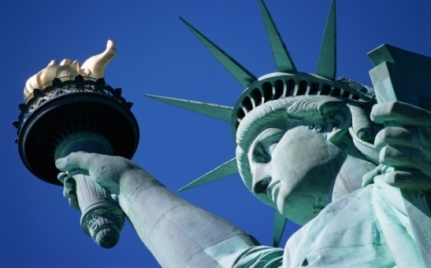
Government: Tourism and .gov Sites
Challenge: States have web sites with varying computing needs throughout the seasons
  CA Ski Reports, FL Beach Conditions, NYC Happenings, Weather or disaster alerts (Hurricane or Earthquake), Traffic, Lottery applications
Why CaaS?
  Flexibility
    Inexpensive way to meet seasonal fluctuation without having to stand up expensive dedicated server farms all year
  Scalability
    Allows customers to scale with the season and/or needs of agencies - including emergencies situations
  Funding
    Online provision and tools allow for chargeback

Slide 54


Higher Education: Enrollment Applications
K-12 and Higher Education: Distance Learning
Challenge: Schools offer online enrollment 2-3 times a year
  Dramatically increases demand for bandwidth, reliability and security
Why CaaS?
  Scalability
    Can provision temporary computing requirements for enrollment applications
    Helps meet peaks or fluctuating enrollment cycles without leaving resources underutilized for large periods of time
    Allows for technology upgrades
  Low Cost
    Reduce CapX to an Opex model
    Eliminates expenses and capacity constraintsK-12 application (i.e eChalk and blackboard applications) require larger computing power the K-12 market may not have
  Compliance and Security
    Provides PCI compliance.

Slide 55



Questions

